Slide 1
Halliday & Resnick’s
Fundamentals of Physics
Extended Edition Wiley
Chapter 15
Jearl Walker
Oscillations

Slide 2
15.1 Oscillatory motion
Motion which is periodic in time, that is, motion that repeats itself in time.
Examples:
Power line oscillates when the wind blows past it
Earthquake oscillations move buildings
  Sometimes the oscillations are so severe, that the system exhibiting oscillations break apart.

Slide 3
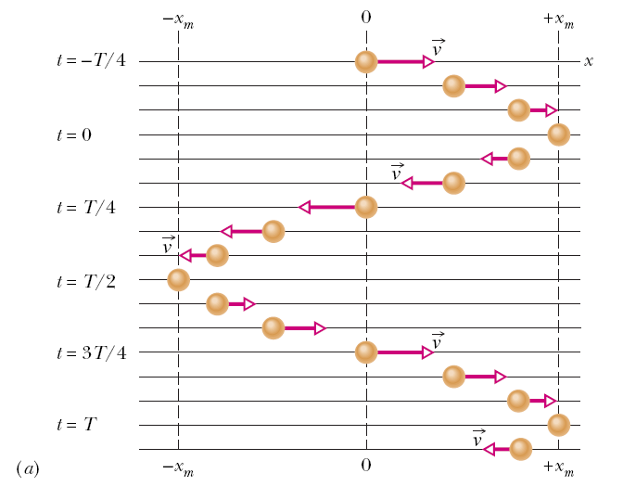
15.2 Simple Harmonic Motion
In the figure snapshots of a simple oscillatory system is shown. A particle repeatedly moves back and forth about the point x=0.
The time taken for one complete oscillation is the period, T. In the time of one T, the system travels from x=+x_{m}, to –x_{m}, and then back to its original position x_{m}.
The velocity vector arrows are scaled to indicate the magnitude of the speed of the system at different times. At x=±x_{m}, the velocity is zero.

Slide 4
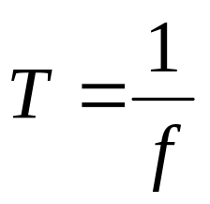
15.2 Simple Harmonic Motion
Frequency of oscillation is the number of oscillations that are completed in each second.
The symbol for frequency is f, and the SI unit is the hertz (abbreviated as Hz).
It follows that

Slide 5
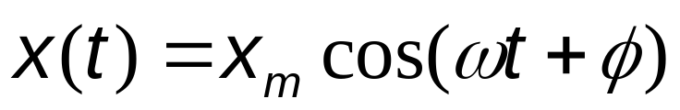
15.2 Simple Harmonic Motion
Any motion that repeats itself is periodic or harmonic.
If the motion is a sinusoidal function of time, it is called simple harmonic motion (SHM).
Mathematically SHM can be expressed as:
Here,
x_{m} is the amplitude (maximum displacement of the system)
t is the time
ω is the angular frequency, and
φ is the phase constant or phase angle

Slide 6
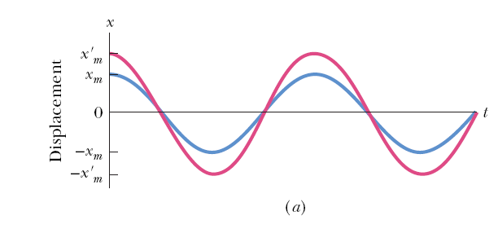
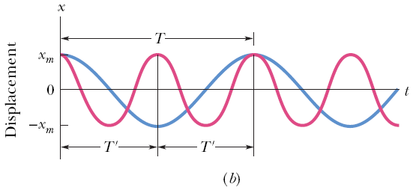
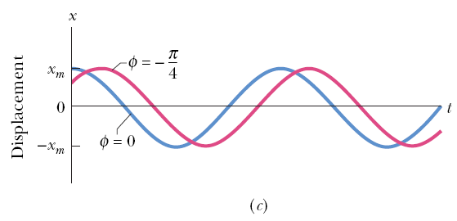
15.2 Simple Harmonic Motion
Figure a plots the displacement of two SHM systems that are different in amplitudes, but have the same period.
Figure b plots the displacement of two SHM systems which are different in periods but have the same amplitude.
The value of the phase constant term, φ, depends on the value of the displacement and the velocity of the system at time t = 0.
Figure c plots the displacement of two SHM systems having the same period and amplitude, but different phase constants.

Slide 7

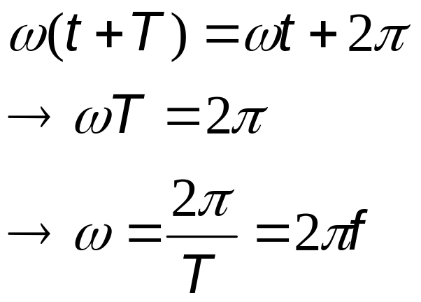
15.2 Simple Harmonic Motion
For an oscillatory motion with period T,
The cosine function also repeats itself when the argument increases by 2π. Therefore,
Here, ω is the angular frequency, and measures the angle per unit time. Its SI unit is radians/second. To be consistent, φ then must be in radians.

Slide 8
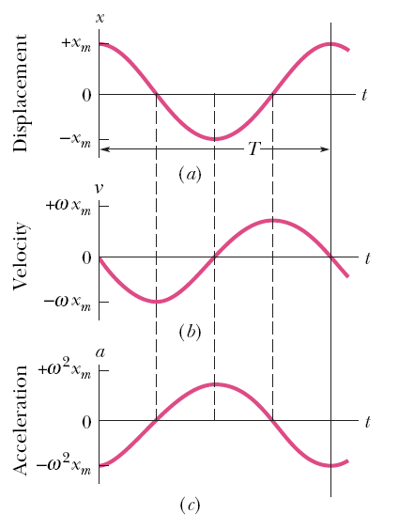
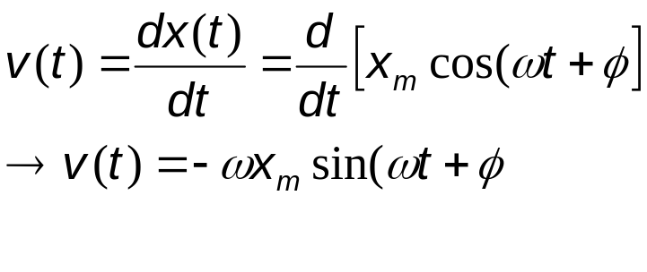
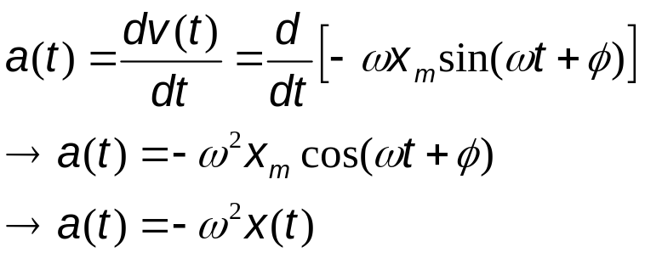
15.2 Simple Harmonic Motion
The velocity of SHM:
The maximum value (amplitude) of velocity is ωx_{m}. The phase shift of the velocity is π/2, making the cosine to a sine function.
The acceleration of SHM is:
The acceleration amplitude is ω²x_{m}.
In SHM a(t) is proportional to the displacement but opposite in sign.

Slide 9

15.3 Force Law for SHM
From Newton’s 2nd law:
SHM is the motion executed by a system subject to a force that is proportional to the displacement of the system but opposite in sign.

Slide 10
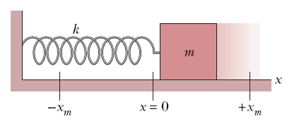
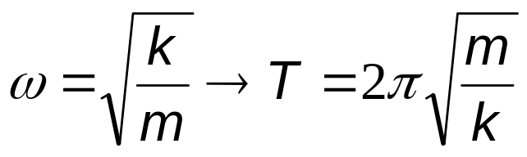
15.3 Force Law for SHM
The block-spring system shown on the right forms a linear SHM oscillator.
The spring constant of the spring, k, is related to the angular frequency, ω, of the oscillator:

Slide 11
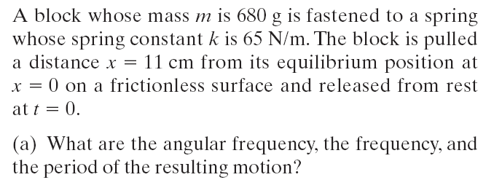
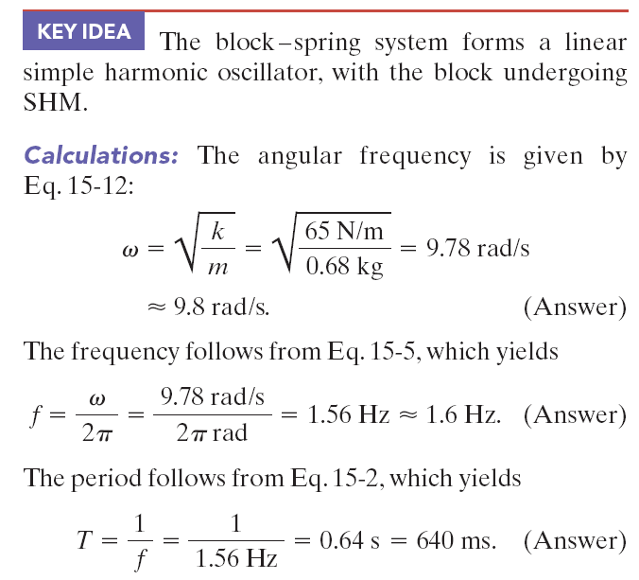
Example, force law:

Slide 12
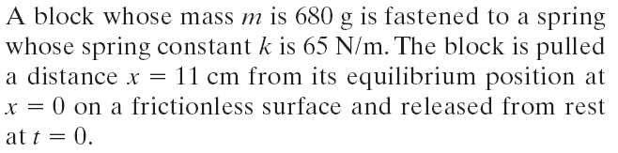
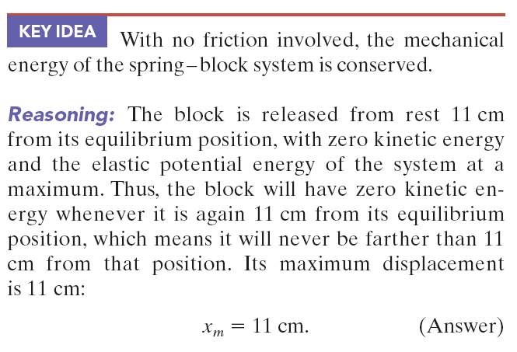
Example, force law:

Slide 13
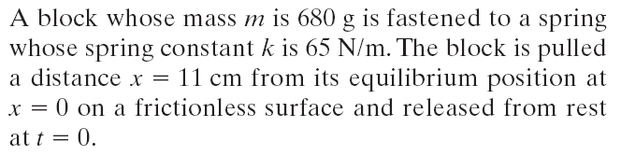


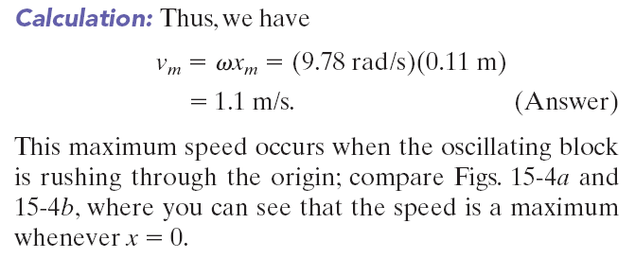
Example, force law:

Slide 14
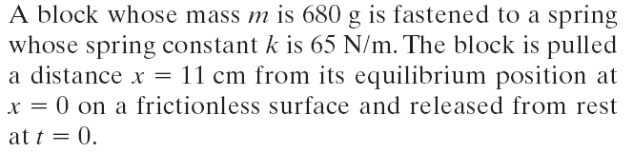

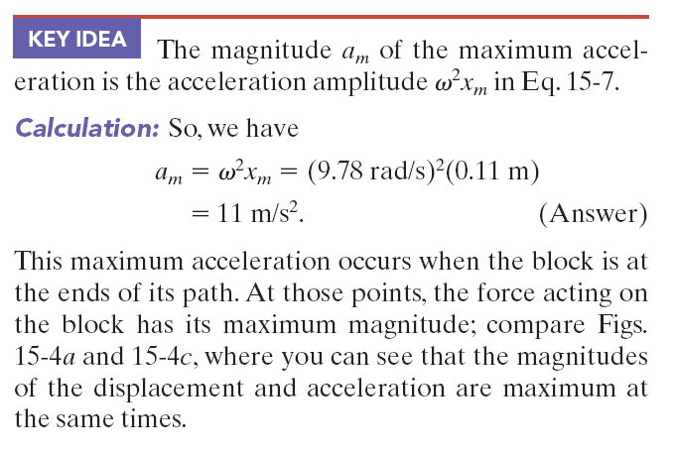
Example, force law:

Slide 15
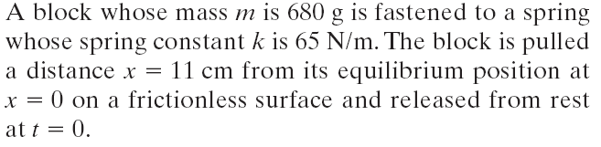
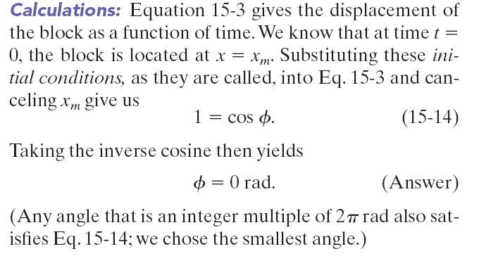
Example, force law:

Slide 16
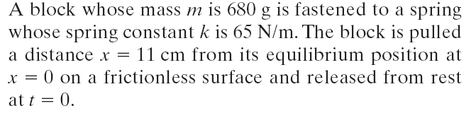

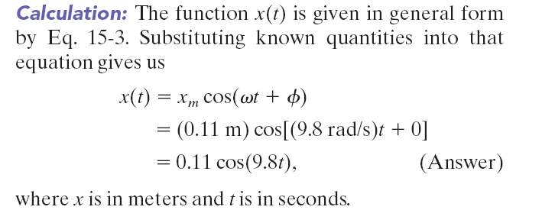
Example, force law:

Slide 17
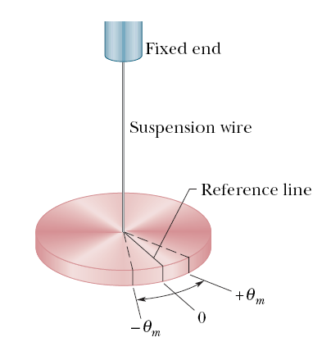
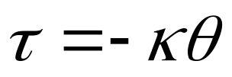
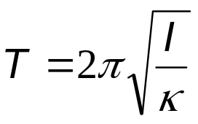
15.4: An Angular SHM
The figure shows an example of angular SHM. In a torsion pendulum involves the twisting of a suspension wire as the disk oscillates in a horizontal plane.
The torque associated with an angular displacement of θ is given by:
is the torsion constant, and depends on the length, diameter, and material of the suspension wire.
The period, T, relates to κ as:
Here, I is the rotational inertia of the oscillating disk.

Slide 18
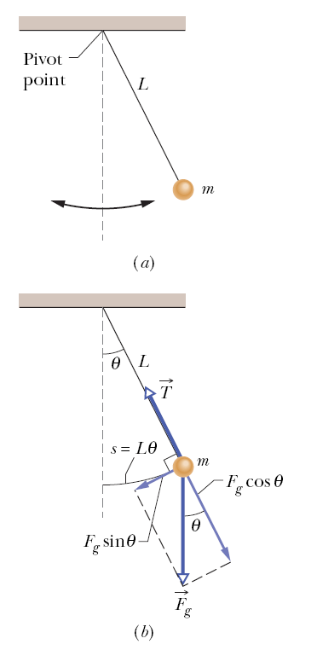
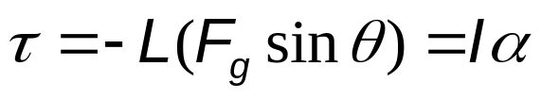
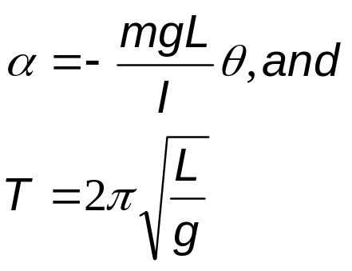
15.6: Pendulums
In a simple pendulum, a particle of mass m is suspended from one end of an unstretchable massless string of length L that is fixed at the other end.
The restoring torque acting on the mass when its angular displacement is θ, is:
α is the angular acceleration of the mass. Finally,
This is true for small angular displacements, θ.

Slide 19
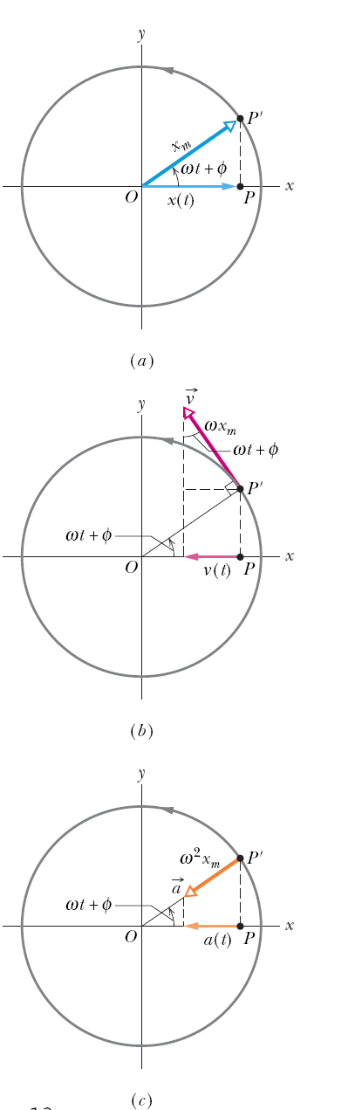

15.7: SHM and uniform circular motion
Consider a reference particle P’ moving in uniform circular motion with constant angular speed (w).
The projection of the particle on the x-axis is a point P, describing motion given by:
This is the displacemnt equation of SHM.
SHM, therefore, is the projection of uniform circular motion on a diameter of the circle in which the circular motion occurs.

